Slide 1
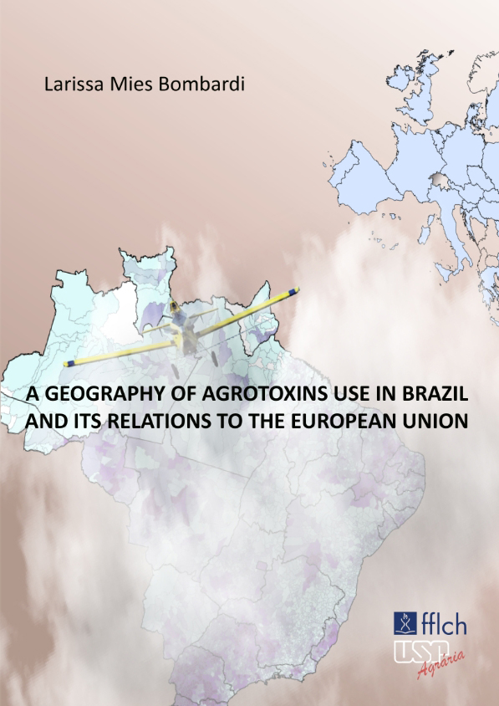
larissab@usp.br

Slide 2

Brazil – One of the main worldwide exporters of:
Soy
Sugar
Ethanol (cane)
Coffee
Orange Juice
Tobacco
Maize
Beef
Chicken
Source: IBGE, MINC, 2010, 2015
Notes:
2
2

Slide 3
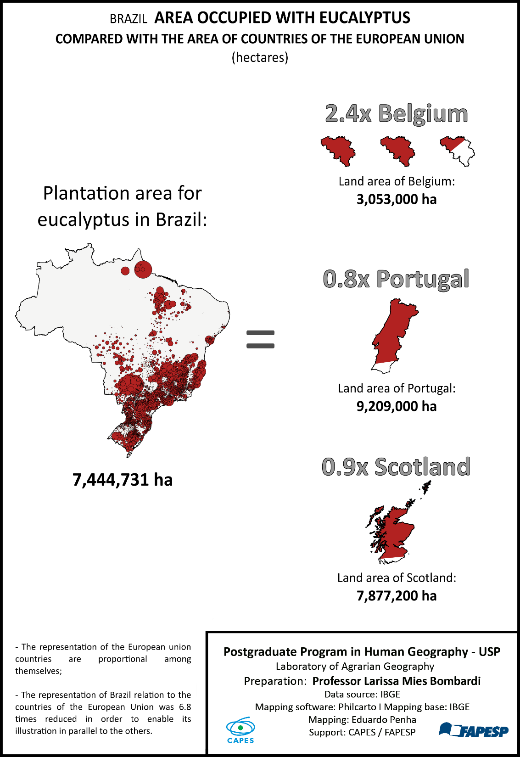

Slide 4
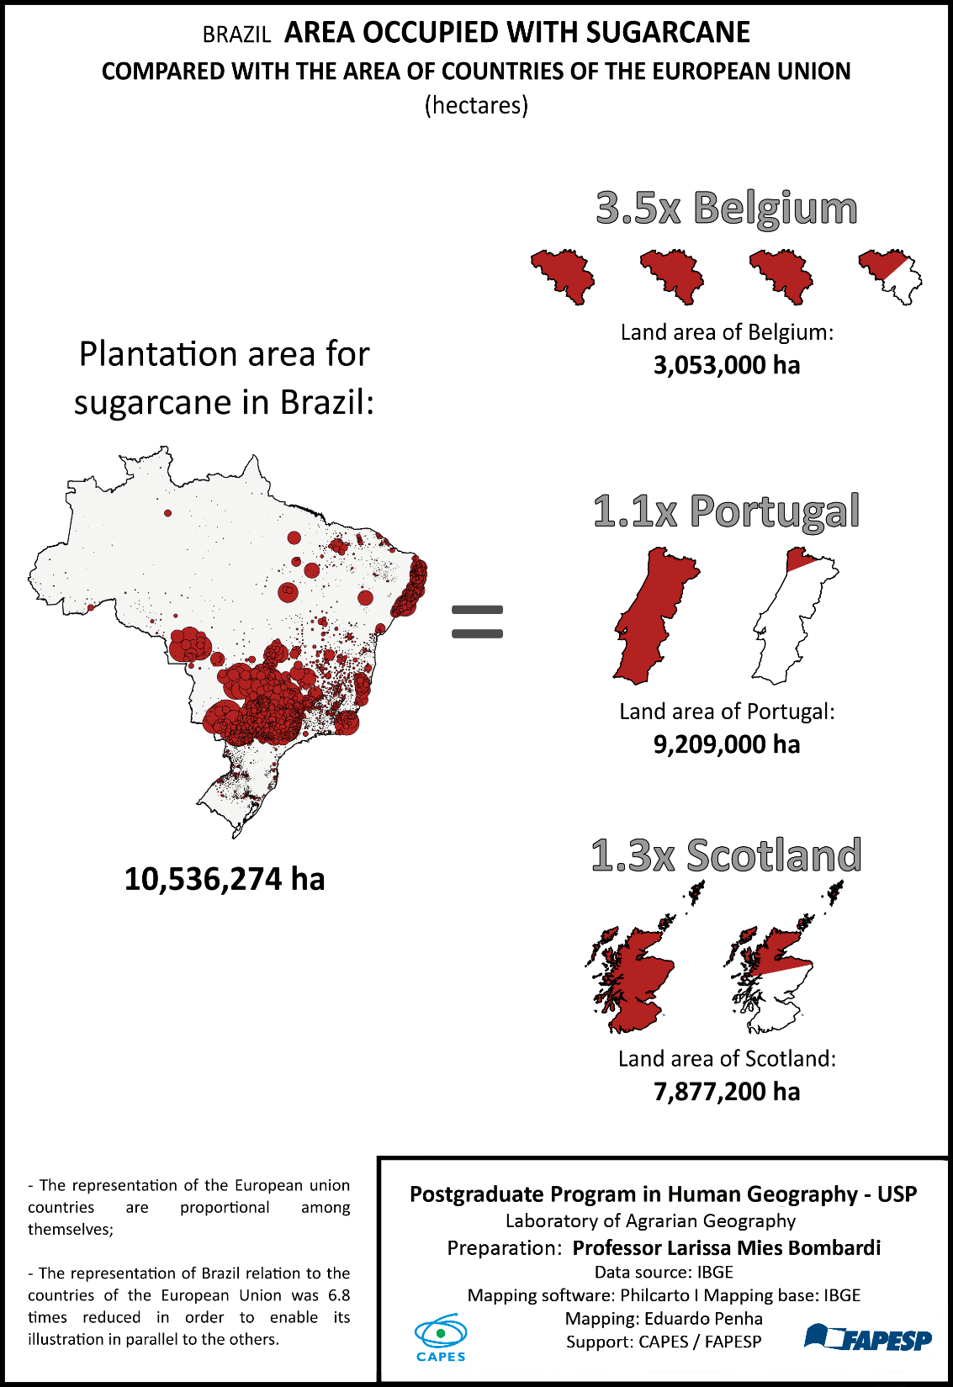

Slide 5
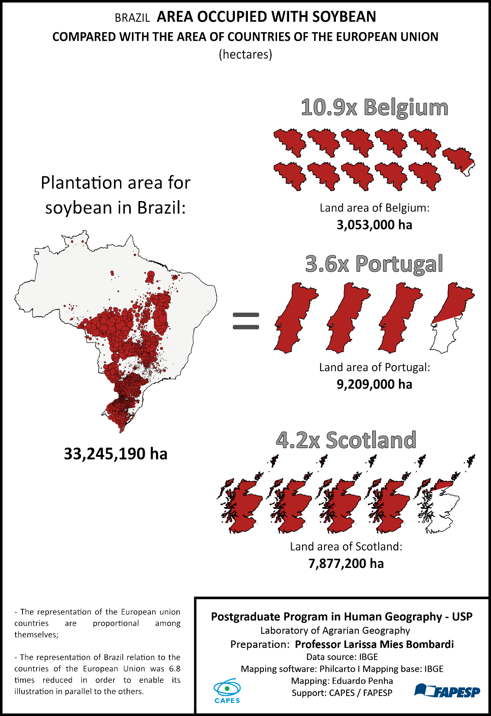

Slide 6
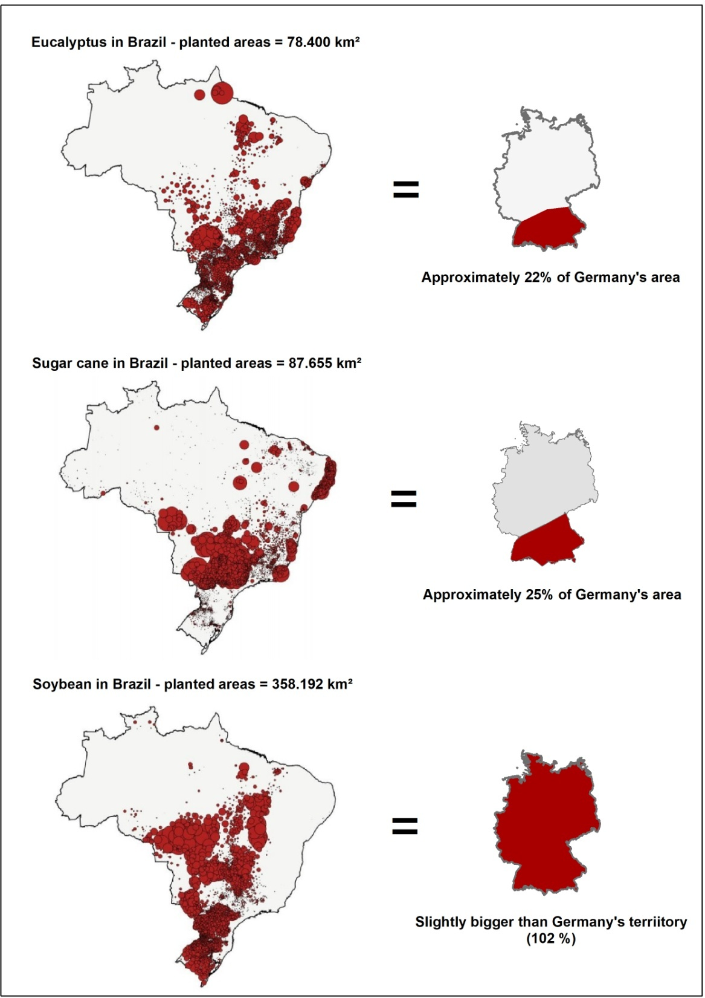
CROPS IN BRAZIL
AND
GERMANY’S TERRITORY

Slide 7
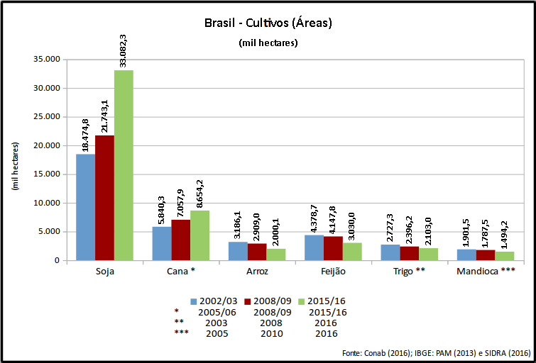
Brazil – Crops (areas)
Soybean
Sugarcane
Rice
Bean
Wheat
Cassava
Notes:
7

Slide 8
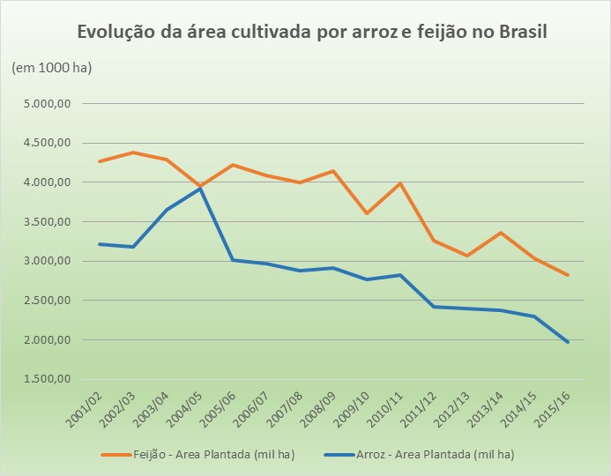
Rice and Beans in Brazil – Evolution of the Grown Area
Source: CONAB, 2018

Slide 9
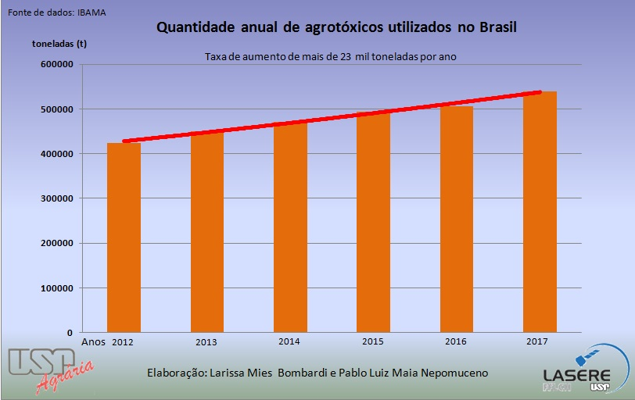
Annual quantity of agrotoxins used in Brazil

Slide 10
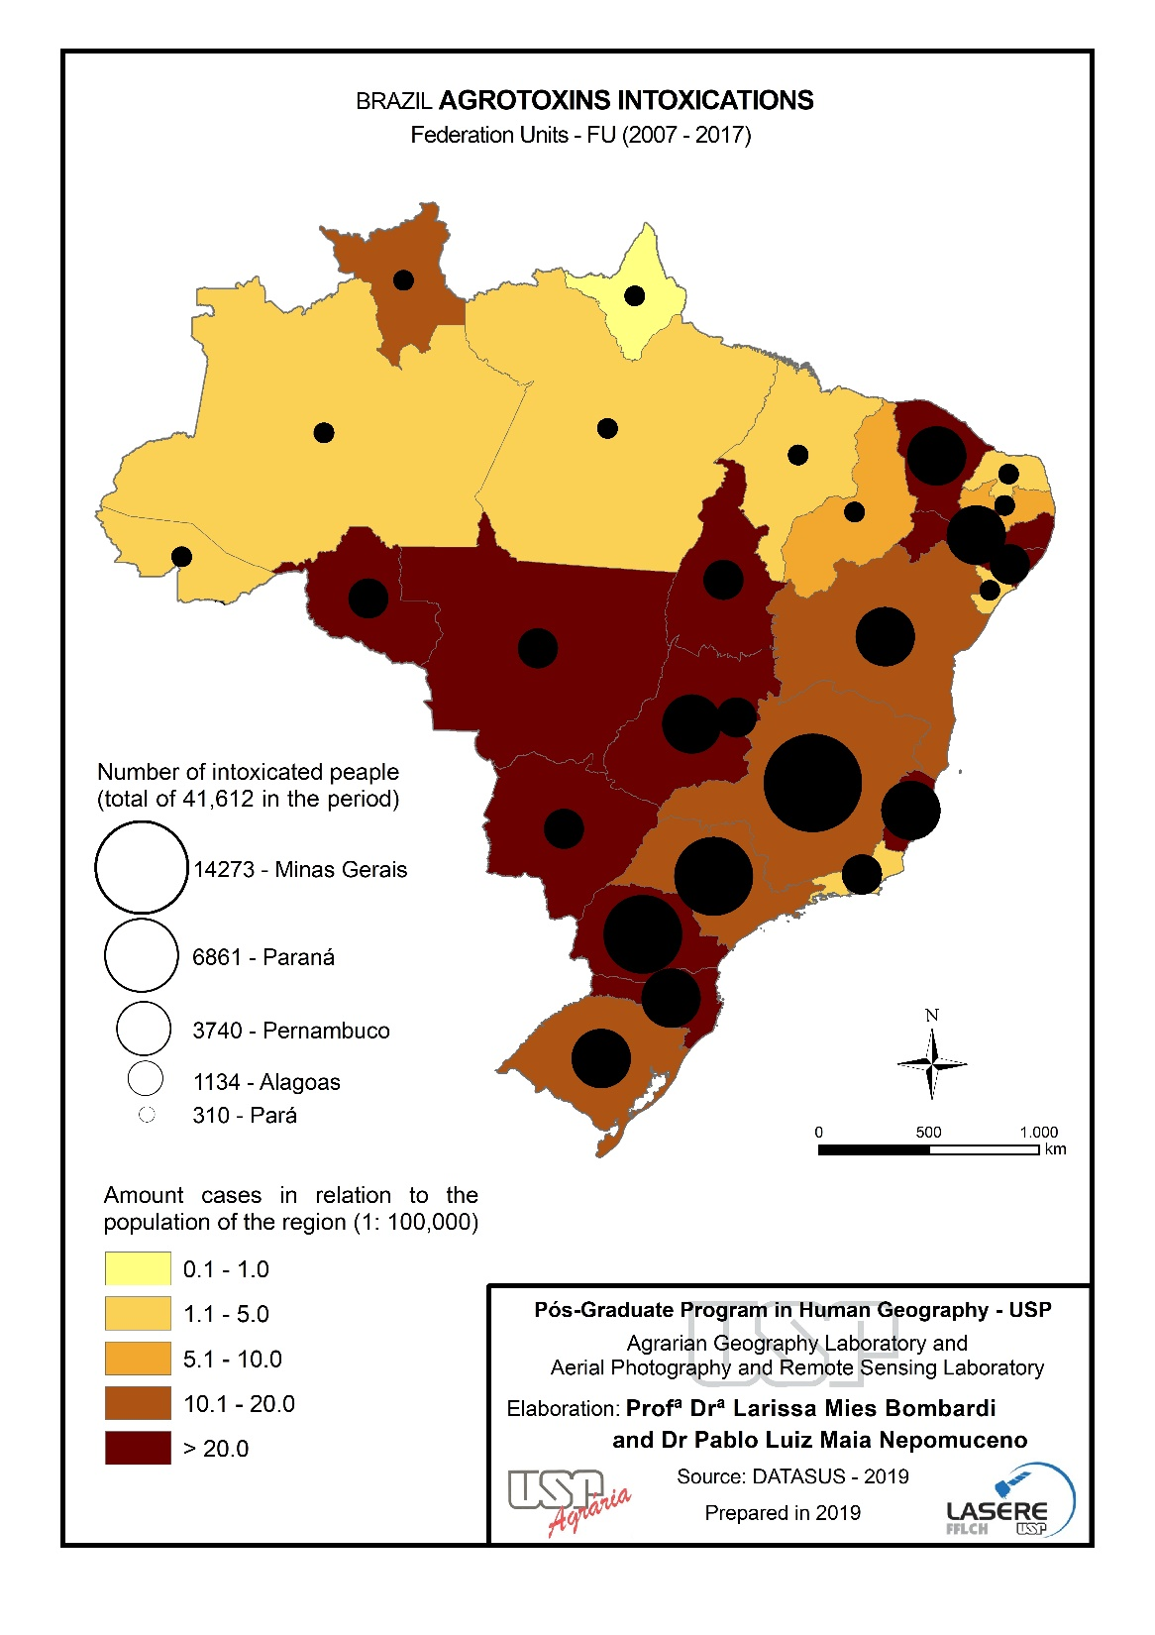

Slide 11
BRAZIL
2007 - 2017
41,612 Intoxicated People
3,782 per year
= 10 per day
Obs: Estimated subnotification: 1 for 50
Source: SINITOX – Health Ministry
Notes:
11
11

Slide 12
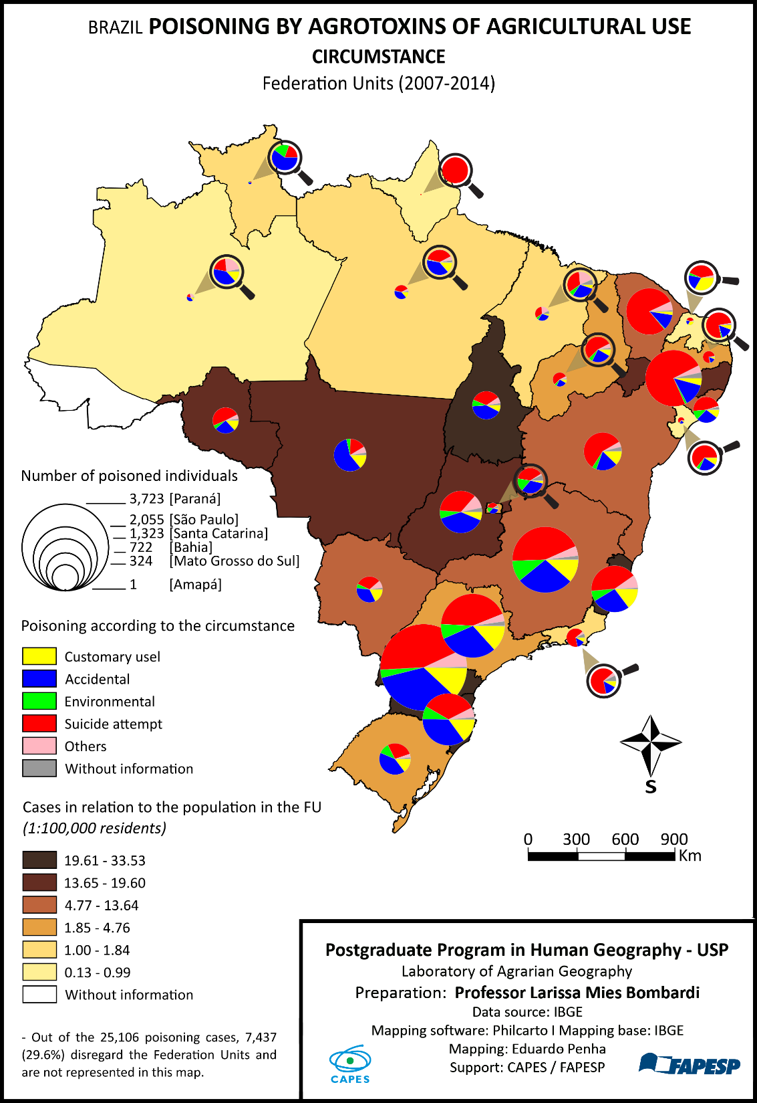

Slide 13
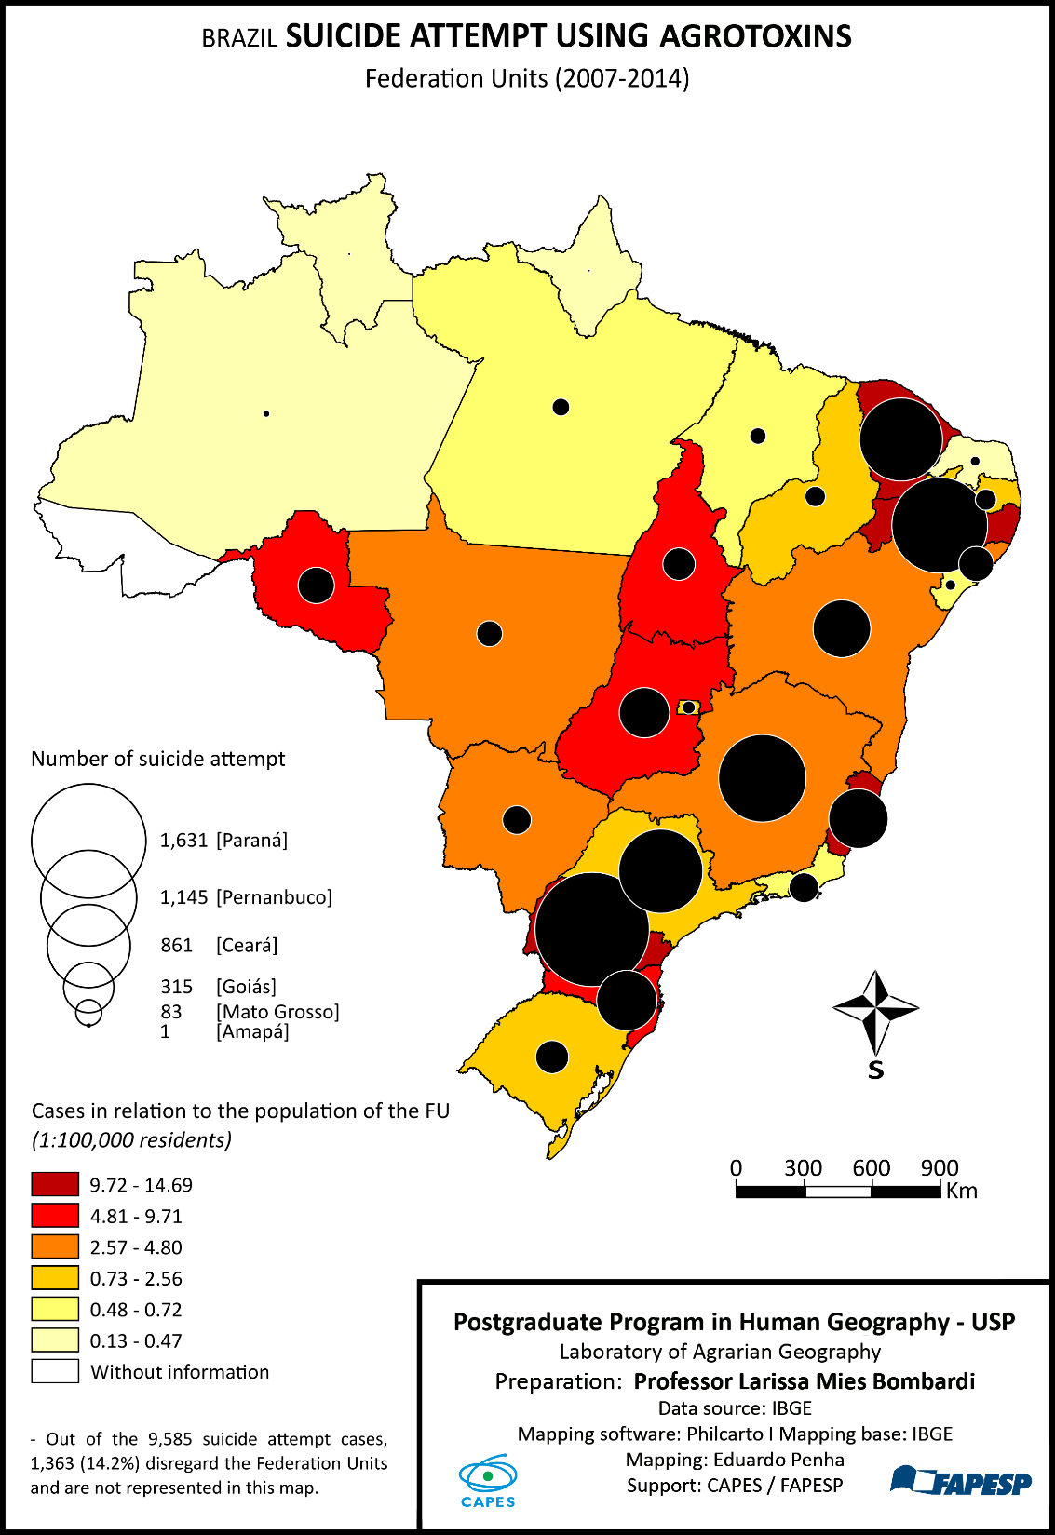

Slide 14
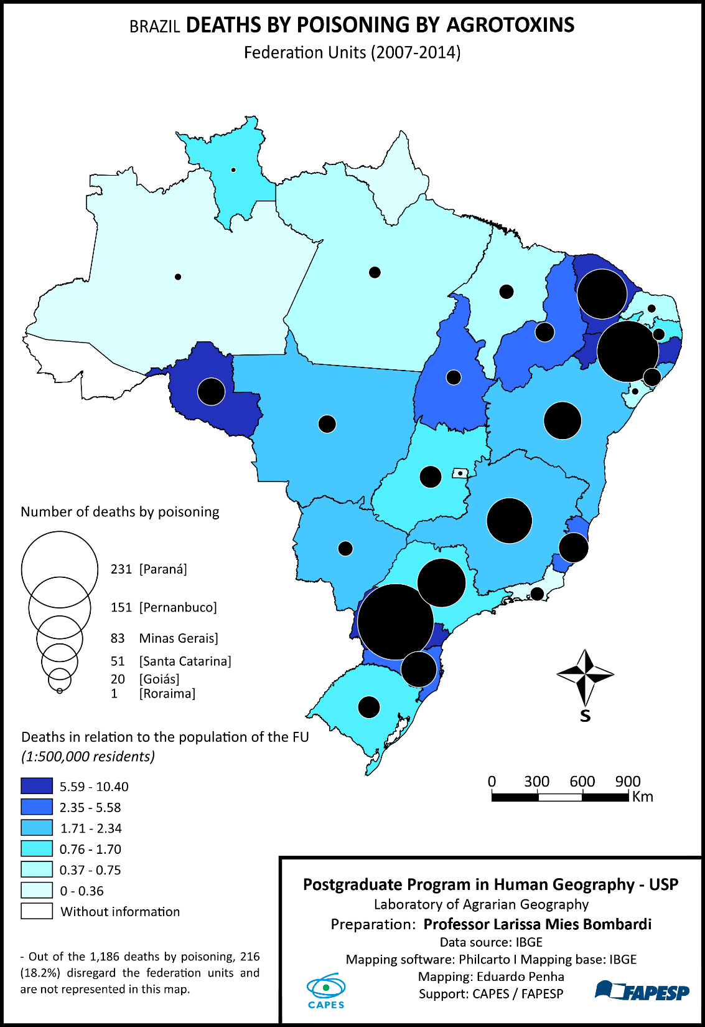

Slide 15
BRAZIL
2007 - 2014
1,186 deaths by pesticide intoxication
= 148 deaths per year
= One each 2 ½ days
Source: SINAN – Ministério da Saúde
Notes:
15
15

Slide 16
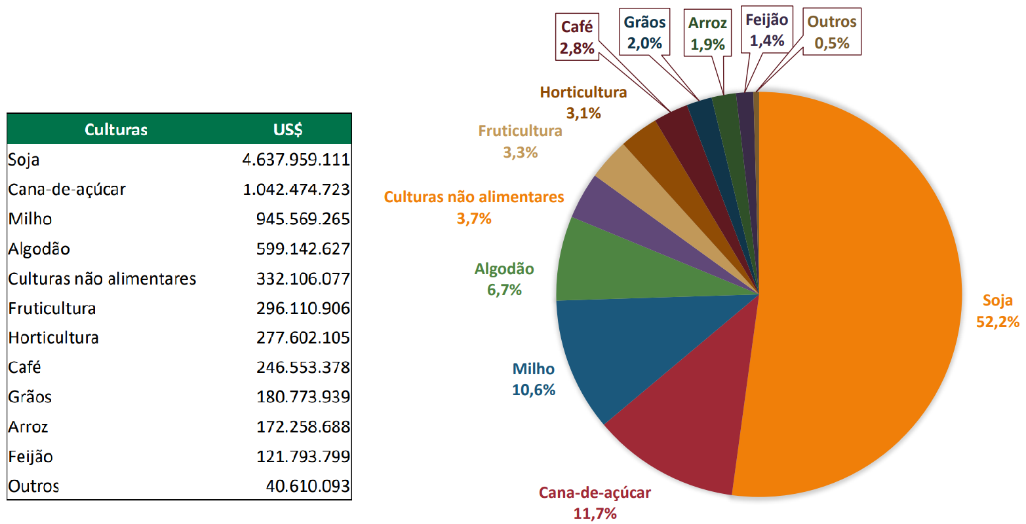
AGROTOXINS USE BY CULTURE (BRAZIL)
Cotton
Soy
Maize
Sugar cane
Source: SINDVEG, 2018

Slide 17
SOY – 98% -
GMOs
About
1 Germany in GMOs

Slide 18
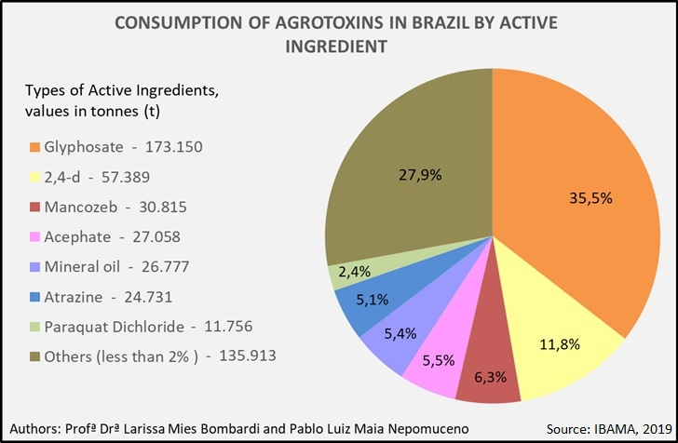
Glyphosate

Slide 19
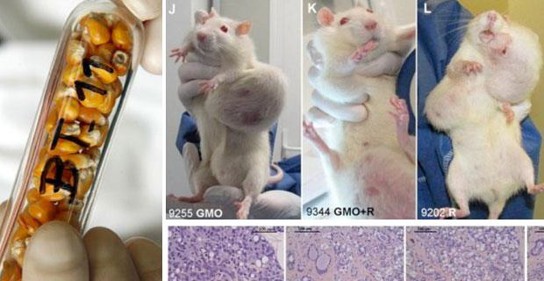
Rats fed with transgenic corn or water containing glyphosate
Em experimentos de longa duração, animais tratados com milho transgênico ou com água contendo Glifosato tiveram morte precoce e desenvolveram tumores, além de outros efeitos.
Fonte: http://hwcdn.net/a6a4d4s9/cds/2012/09/i/general/gmo_study_shows_rat_cancer_scientist_defends.jpg?dopvhost=static.infowars.com&x-hw-redirect=dop005.sp3.hwcdn.net
IN: Parecer Técnico sobre o Ingrediente Ativo Glifosato elaborado por: Profª Drª Sonia Corina Hess e Prof. Dr. Rubens Onofre Nodari
Notes:
19

Slide 20
Glyphosate

Slide 21
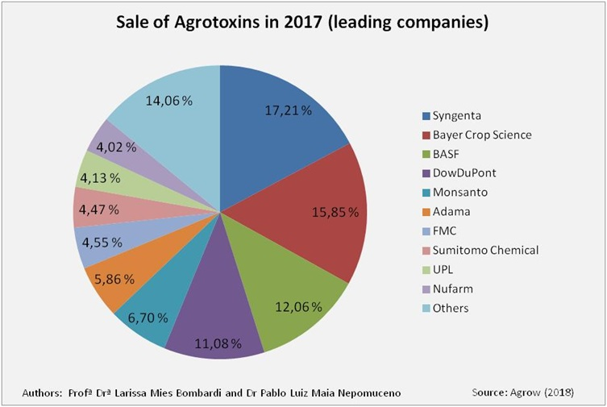

Slide 22
AGROCHEMICAL – GLOBAL SALES
OF THE LEADING COMPANIES (2017)
($ Million)
1. Syngenta 9,244
2. Bayer 8,714
3. BASF 6,704
4. DowDuPont 6,100
5. Monsanto 3,727
6. Adama 3,259
Source: Agrow (2018).
70% (global sales)
= $ 37,747

Slide 23
LEADING COMPANIES
By Headquarters
(% Sales and $ million)
Germany Companies
Bayer + Monsanto* (15.85%+6.7%)
BASF 12.06%
Chinese Companies
Syngenta 17.21%
Adama 5.8%
US Company
DowDuPont 11.08%
* Bayer bought Monsanto in 2018.
34.61% = $19,144
23.01% = $12,503
11.08% = $6,100
Source: Agrow (2018)

Slide 24
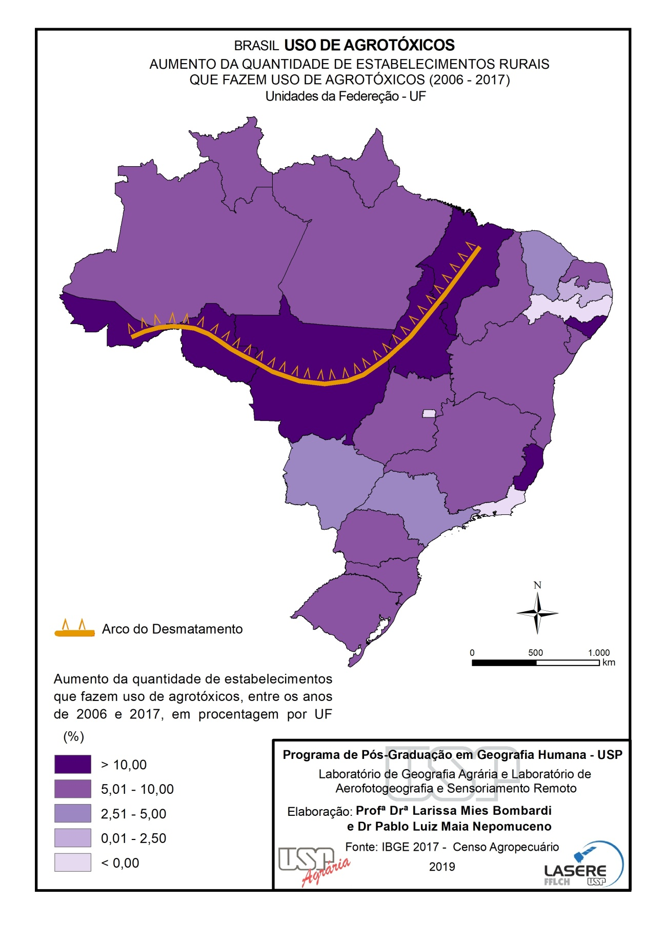

Slide 25
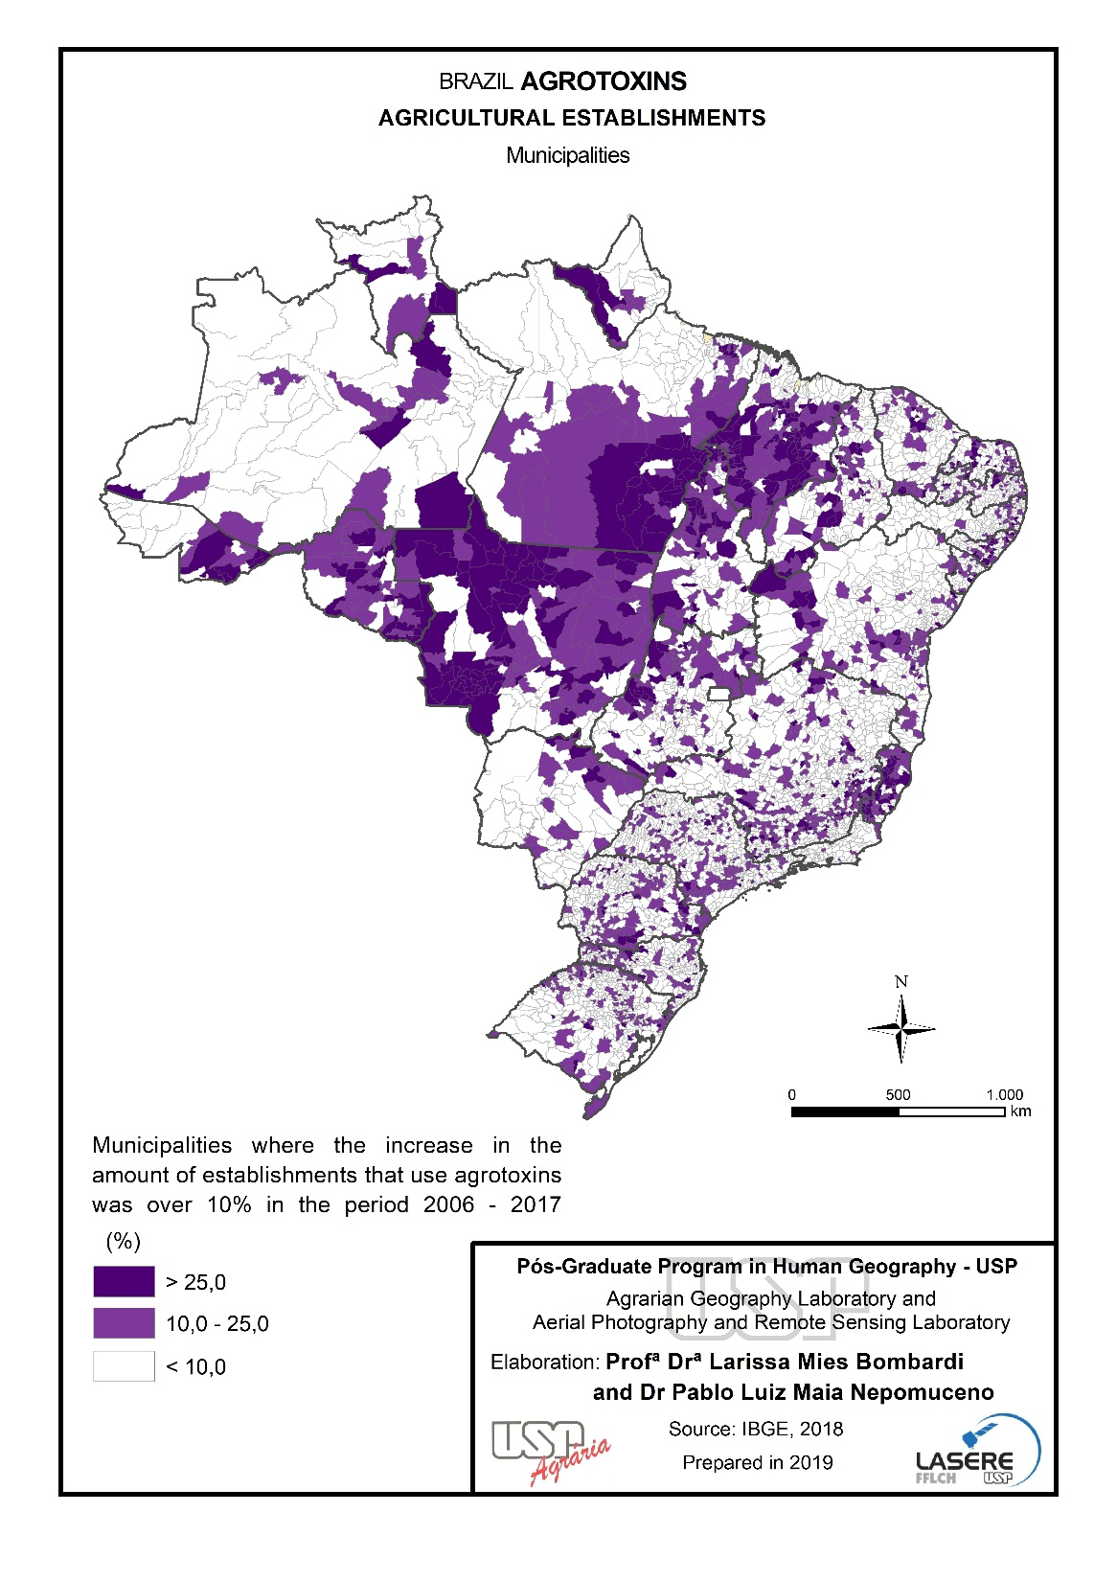

Slide 26
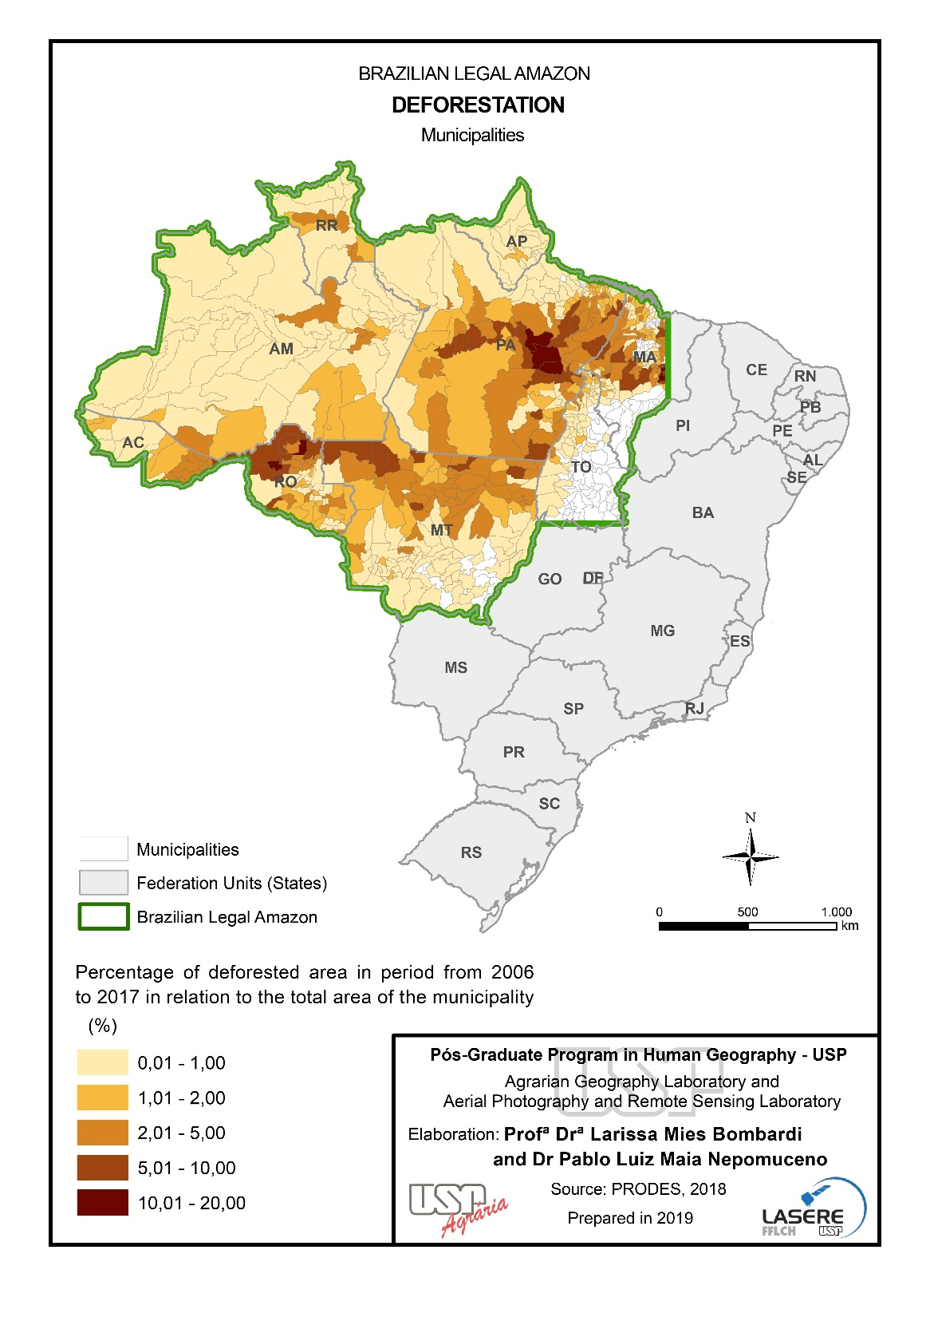

Slide 27
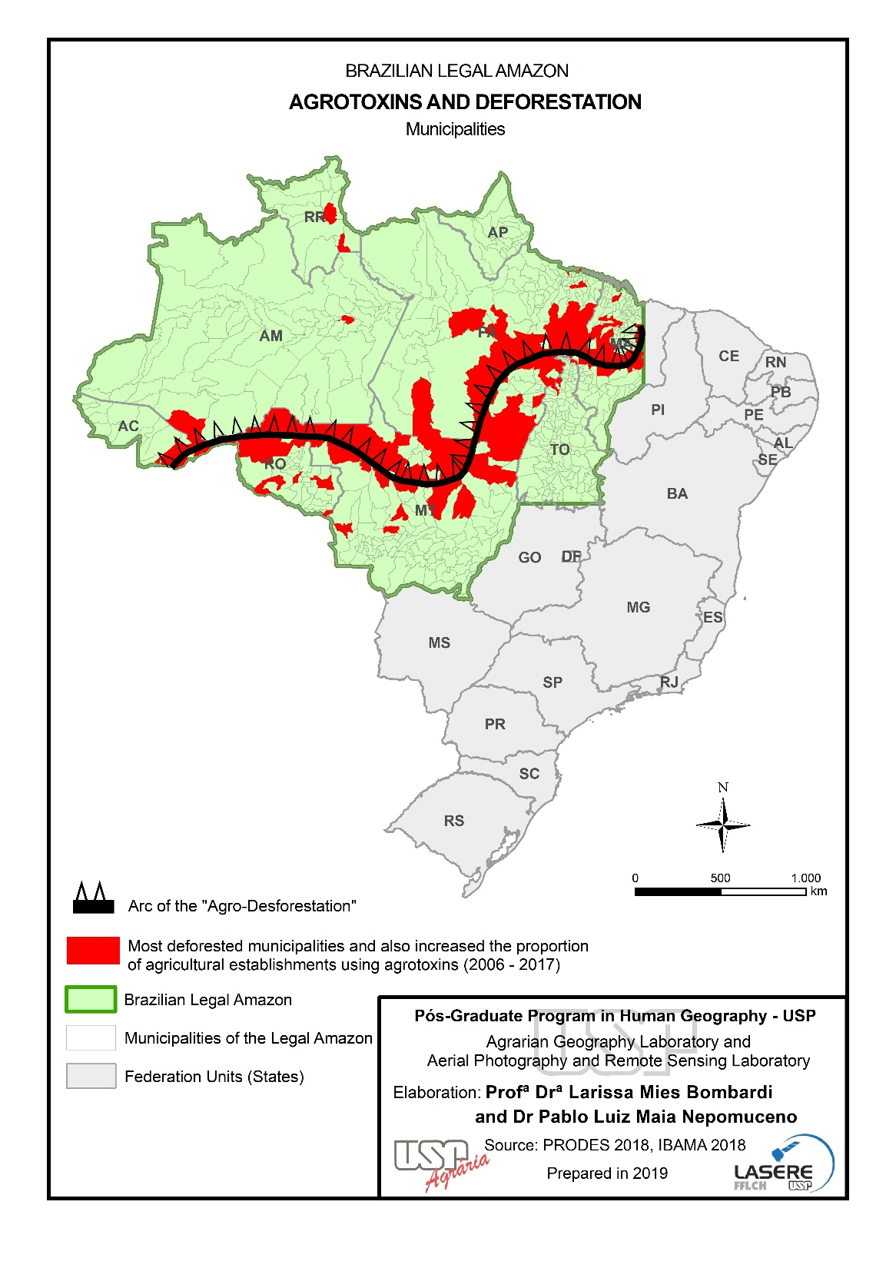

Slide 28
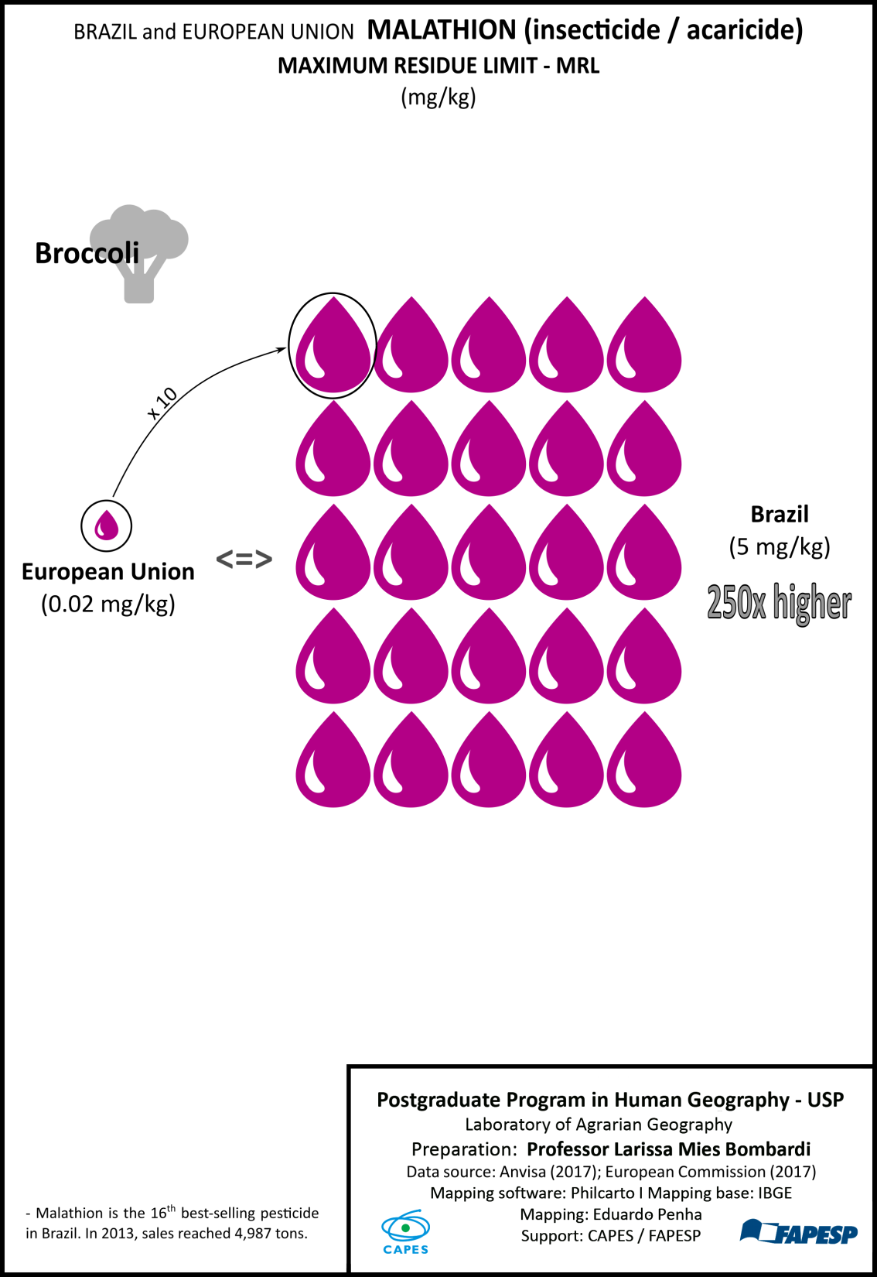

Slide 29
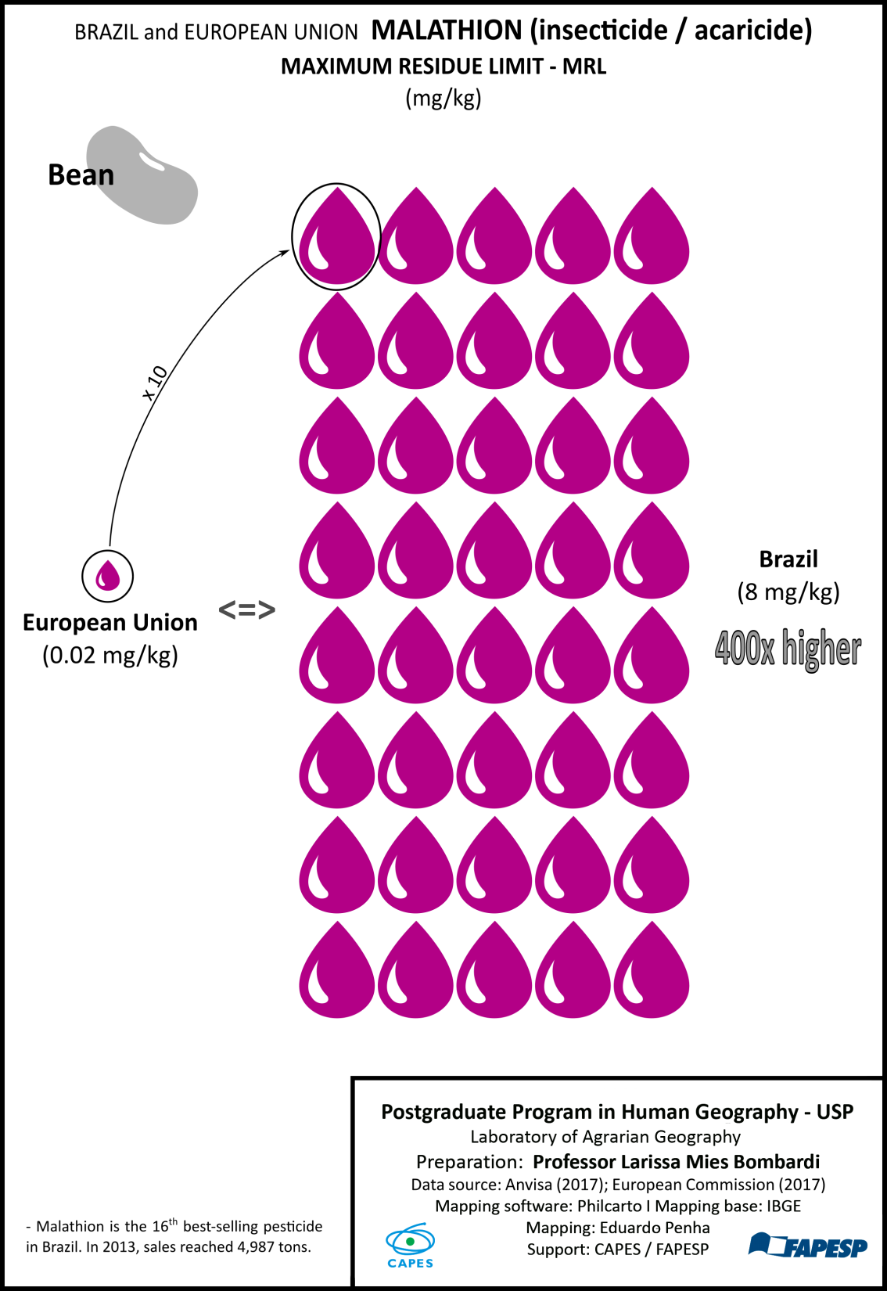

Slide 30
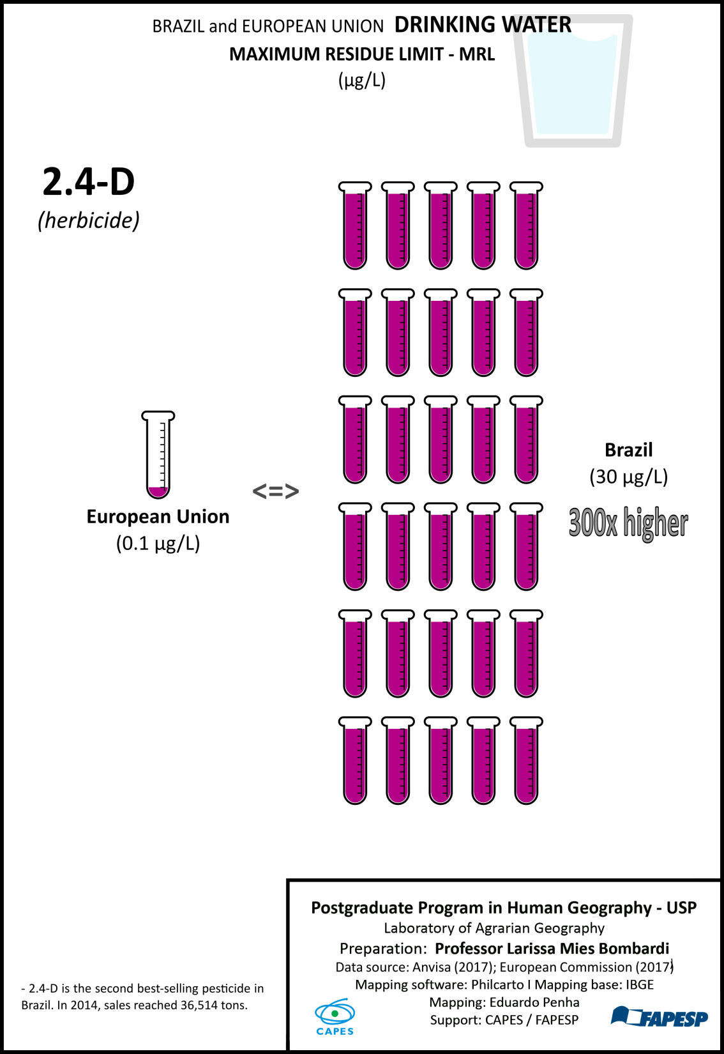

Slide 31
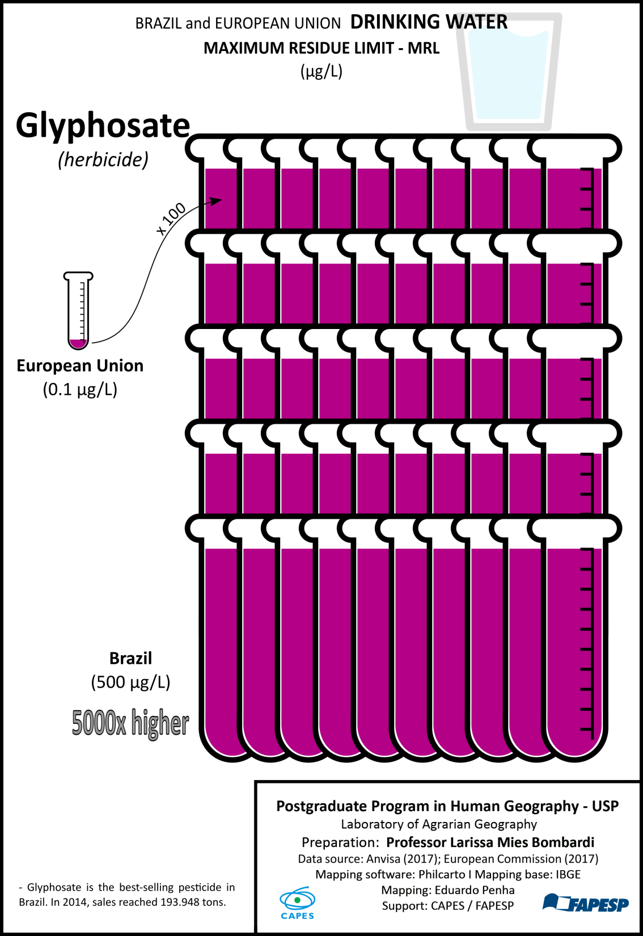

Slide 32
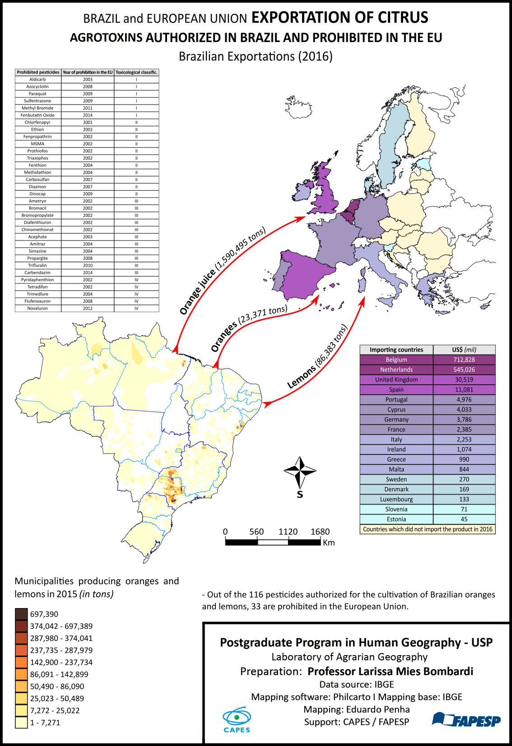

Slide 33
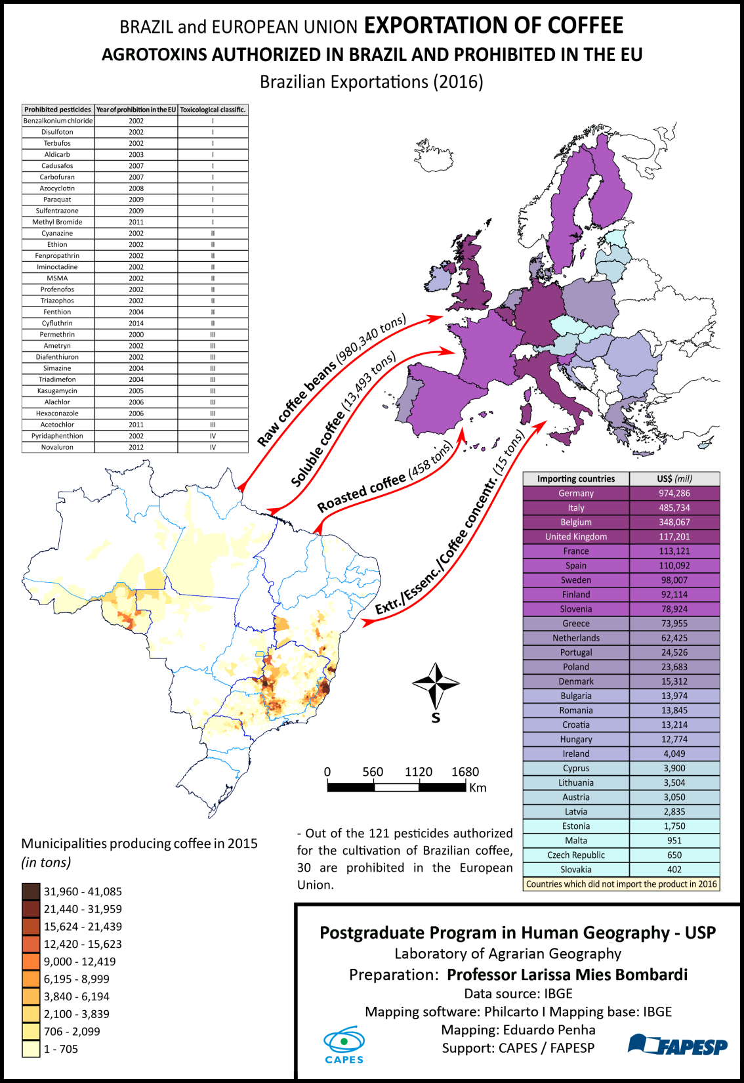

Slide 34
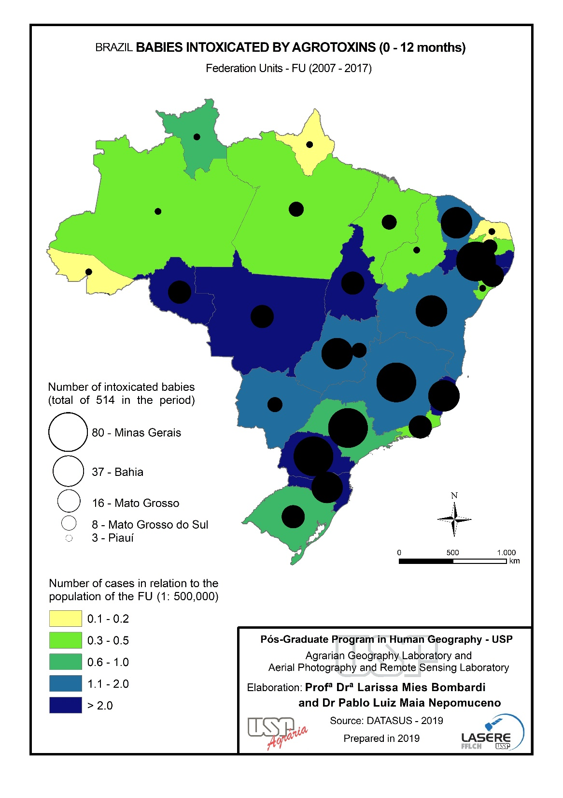

Slide 35
BRAZIL
514 babies (0 - 12 months old) intoxicated by agrotoxins between 2007 and 2017 (reported cases).
Possibly: 25,700 babies (0 - 12 months old) intoxicated between 2007 and 2014.
Source: Health Ministry /SINAN

Slide 36
ATLAS – “A Geography of Agrotoxins Use in Brazil and its Relations to the European Union”
Available for download on:
http://www.livrosabertos.sibi.usp.br/portaldelivrosUSP/catalog/book/352
Notes:
36

